Slide 1
K NEAREST NEIGHBOUR
KNN

Slide 2
INTRODUCTION
K-Nearest Neighbors (KNN) is one of the simplest algorithms used in Machine Learning for regression and classification problem. KNN algorithms use data and classify new data points based on similarity measures (e.g. distance function). ... The data is assigned to the class which has the nearest neighbors.
It is used for classification and regression. In both cases, the input consists of the k closest training examples in data set. The output depends on whether k-NN is used for classification or regression.
It is also called as Lazy learning.
It is supervised machine learning algorithm, use to solve both regression and classification problem.

Slide 3
What is K in KNN?
K is a number used to identify similar neighbors for the new data point.
KNN takes K nearest neighbors to decide where the new data point with belong to.
This decision is based on feature similarity.

Slide 4
STEPS OF KNN
Step 1: Choose a value for K. K should be an odd number.
Step2: Find the distance of the new point to each of the training data.
Step 3:Find the K nearest neighbors to the new data point.
Step 4: For Classification, count the number of data points in each category
among the k neighbors. New data point will belong to class that has the most neighbors.
For Regression, value for the new data point will be the average of the k neighbors.

Slide 5
Following dataset gives the marks of student in maths and cs and accordingly result is decided
MATHS | CS | RESULT
4 | 3 | FAIL
6 | 7 | PASS
7 | 8 | PASS
5 | 5 | FAIL
8 | 8 | PASS
If we want to predict the result of new student whose marks and K value is known,we use KNN method here.
Maths=6 and cs=8 k=3
First use Euclidean formula to find the distance

Slide 6
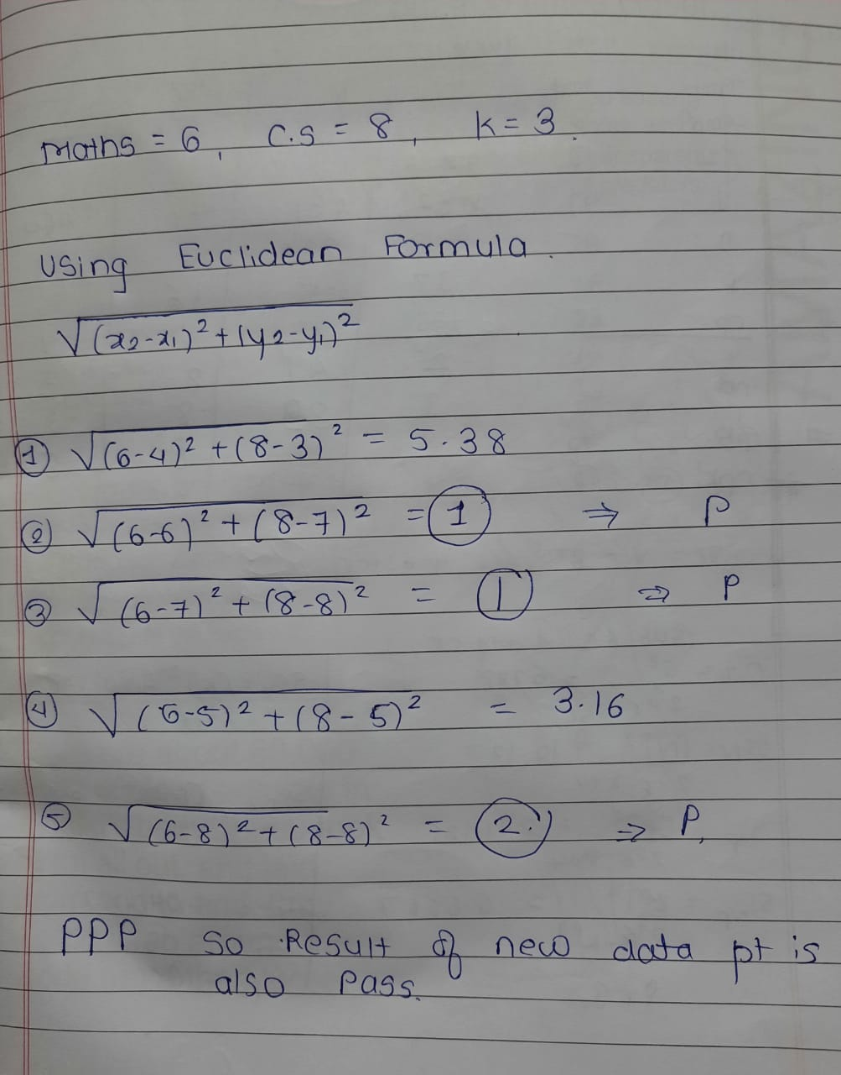
MATHS | CS | RESULT
4 | 3 | FAIL
6 | 7 | PASS
7 | 8 | PASS
5 | 5 | FAIL
8 | 8 | PASS

Slide 7
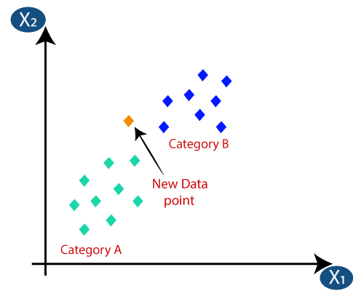
Suppose we have a new data point and we need to put it in the required category. Consider the below image:

Slide 8
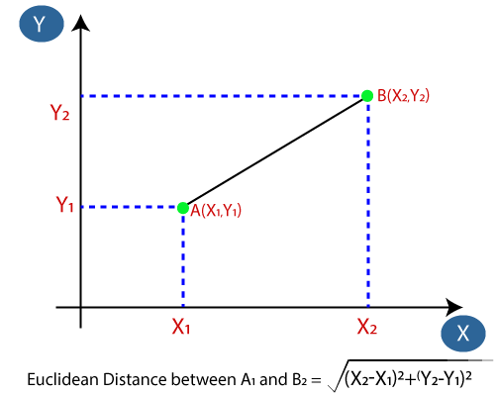
Firstly, we will choose the number of neighbors, so we will choose the k=5.
Next, we will calculate the Euclidean distance between the data points. The Euclidean distance is the distance between two points, which we have already studied in geometry. It can be calculated as:

Slide 9
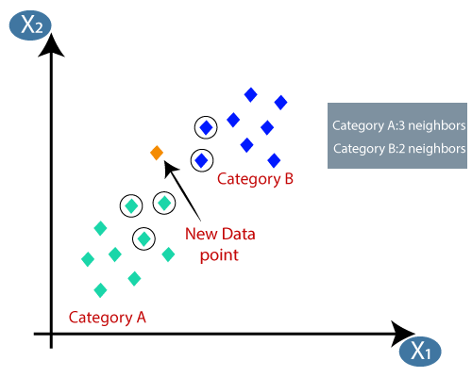
By calculating the Euclidean distance we got the nearest neighbors, as three nearest neighbors in category A and two nearest neighbors in category B. Consider the below image:
As we can see the 3 nearest neighbors are from category A, hence this new data point must belong to category A.

Slide 10
CALCULATION OF DISTANCE IN KNN
EUCLIDEAN DISTANCE FORMULA
MANHATTAN DISTANCE FORMULA

Slide 11
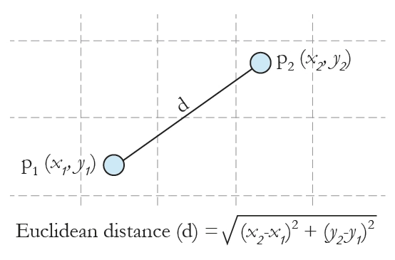
EUCLIDEAN FORMULA

Slide 12
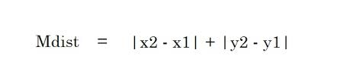
MANHATTAN FORMULA
Manhattan distance is calculated as the sum of the absolute differences between the two vectors.

Slide 13
ADVANTAGES
Quick calculation time.
Simple algorithm – to interpret.
Versatile – useful for regression and classification.
High accuracy – you do not need to compare with better-supervised learning models.

Slide 14
DISADVANTAGES
With large data, the prediction stage might be slow.
It can be computationally expensive.

Slide 15
THANK YOU

